Slide 1
DETECTION OF SOCIAL NETWORK MENTAL Disorders THROUGH MINING OF ONLINE SOCIAL MEDIA
BY -
V. RETESH KUMAR - (19RA1A0530)
GOUTHAM SURYA - (19RA1A0550)
V.YUVARAJ - (20RA5A0510)

Slide 2
abstract
The explosive growth in popularity of social networking results in the problematic usage. The increase in number of social network mental disorders (SNMDs), like Cyber-Relationship Addiction, Information Overload, and Net Compulsion, are very much observable. Symptoms of those mental disorders are usually observed passively today, leading to delayed clinical intervention. In this paper, we argue that mining online social behavior provides a chance to actively identify SNMDs at an early stage. It is challenging to detect SNMDs because the mental status can't be directly observed from online group action logs. A new and innovative approach to the practice of SNMD detection, doesn't believe self-revealing of those mental factors via questionnaires in Psychology. Instead, we initiate a machine learning framework, namely, By extracting the features from social data we detect the potential cases of SNMD. We also exploit multi-source learning in SNMDD and propose a replacement SNMD-based Tensor Model(STM)to improve the accuracy. To increase the scalability of STM, we further try to increase the efficiency with performance guarantee.

Slide 3
INTRODUCTION
With the explosive growth in popularity of social networking and messaging apps, online social networks (OSNs) became a neighborhood of the many people’s daily lives
While OSNs seemingly expand their users’ capability in increasing social contacts, they'll actually decrease the face-to-face interpersonal interactions within the world . Due to the epidemic scale of these phenomena, new terms like Phubbing (Phone Snubbing) and Nomophobia (No mobile Phobia).
In fact, some social network mental disorders (SNMDs), such as Information Overload and Net Compulsion, have been recently noted.
Indeed, these symptoms are important components of diagnostic criteria for SNMDs e.g., excessive use of social networking apps – usually associated with a loss of the sense of your time or a neglect of basic drives, and withdrawal – including feelings of anger, tension, and/or depression when the computer/apps are inaccessible.

Slide 4
LITERATURE SURVEY
Zhang address the multiple emotions detection in OSNs from user-level view, and formulate this problem as a multilabel learning problem. First, they discover emotion labels correlations, social correlations, and temporal correlations from an annotated Twitter data set. Second, based on the above observations, they adopt a factor graph-based emotion recognition model to incorporate emotion labels correlations, social correlations, and temporal correlations into a general framework, and detect the multiple emotions based on the multilabel learning approach
Shuai proposed a machine learning framework, namely, Social Network Mental Disorder Detection (SNMDD), that exploits features extracted from social network data to accurately identify potential cases of SNMDs.
Tadesse et employ the Natural Language Processing (NLP) techniques and machine learning approaches to train the data and evaluate the efficiency of our proposed method. They identify a lexicon of terms that are more common among depressed accounts. The results show that our proposed method can significantly improve performance accuracy.
Katchapakirin employs Natural Language Processing (NLP) techniques to develop a depression detection algorithm for the Thai language on Facebook where people use it as a tool for sharing opinions, feelings, and life events

Slide 5
Existing system
K-Nearest Neighbour (KNN) Algorithm
K-Nearest Neighbour is one of the simplest Machine Learning algorithms based on Supervised Learning technique.
K-NN algorithm assumes the similarity between the new case/data and available cases and put the new case into the category that is most similar to the available categories.
K-NN algorithm stores all the available data and classifies a new data point based on the similarity. This means when new data appears then it can be easily classified into a well suite category by using K- NN algorithm.
K-NN is a non-parametric algorithm, which means it does not make any assumption on underlying data.

Slide 6
Draw backs of existing system
Accuracy depends on the quality of the data.
With large data, the prediction stage might be slow.
Sensitive to the scale of the data and irrelevant features.
Require high memory – need to store all of the training data.
Given that it stores all of the training, it can be computationally expensive.

Slide 7
Proposed system
Data pre-processing is a process of preparing the raw data and making it suitable for a machine learning model. It is the first and crucial step while creating a machine learning model. When creating a machine learning project, it is not always a case that we come across the clean and formatted data. And while doing any operation with data, it is mandatory to clean it and put in a formatted way. So, for this, we use data pre-processing task.
A real-world data generally contains noises, missing values, and maybe in an unusable format which cannot be directly used for machine learning models. Data pre-processing is required tasks for cleaning the data and making it suitable for a machine learning model which also increases the accuracy and efficiency of a machine learning model.

Slide 8
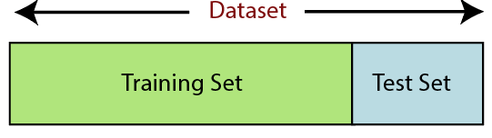
Proposed system
In machine learning data pre-processing, we divide our dataset into a training set and test set. This is one of the crucial steps of data pre-processing as by doing this, we can enhance the performance of our machine learning model.
Training Set: A subset of dataset to train the machine learning model, and we already know the output.
Test set: A subset of dataset to test the machine learning model, and by using the test set, model predicts the output.

Slide 9
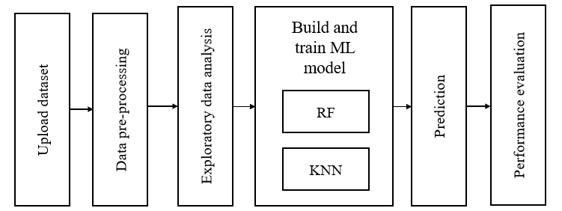
Block diagram of proposed system.

Slide 10
Advantages of proposed system
It can be used in classification and regression problems.
It solves the problem of overfitting as output is based on majority voting or averaging.
It performs well even if the data contains null/missing values.
Each decision tree created is independent of the other thus it shows the property of parallelization.
It is highly stable as the average answers given by a large number of trees are taken.
It maintains diversity as all the attributes are not considered while making each decision tree though it is not true in all cases.
It is immune to the curse of dimensionality. Since each tree does not consider all the attributes, feature space is reduced.

Slide 11
Random forest algorithm
Random Forest is a popular machine learning algorithm that belongs to the supervised learning technique. It can be used for both Classification and Regression problems in ML. It is based on the concept of ensemble learning, which is a process of combining multiple classifiers to solve a complex problem and to improve the performance of the model. As the name suggests, "Random Forest is a classifier that contains a number of decision trees on various subsets of the given dataset and takes the average to improve the predictive accuracy of that dataset." Instead of relying on one decision tree, the random forest takes the prediction from each tree and based on the majority votes of predictions, and it predicts the final output. The greater number of trees in the forest leads to higher accuracy and prevents the problem of overfitting.

Slide 12
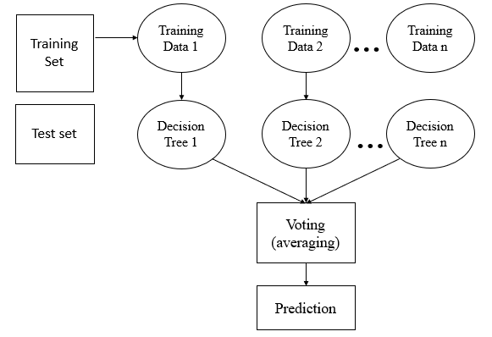
Random Forest algorithm

Slide 13
Features of random forest
Diversity- Not all attributes/variables/features are considered while making an individual tree, each tree is different.
Immune to the curse of dimensionality- Since each tree does not consider all the features, the feature space is reduced.
Parallelization-Each tree is created independently out of different data and attributes. This means that we can make full use of the CPU to build random forests.
Train-Test split- In a random forest we don’t have to segregate the data for train and test as there will always be 30% of the data which is not seen by the decision tree.
Stability- Stability arises because the result is based on majority voting/ averaging.

Slide 14
Machine learning
Before we take a look at the details of various machine learning methods, let's start by looking at what machine learning is, and what it isn't. Machine learning is often categorized as a subfield of artificial intelligence, but I find that categorization can often be misleading at first brush. The study of machine learning certainly arose from research in this context, but in the data science application of machine learning methods, it's more helpful to think of machine learning as a means of building models of data.
Fundamentally, machine learning involves building mathematical models to help understand data. "Learning" enters the fray when we give these models tunable parameters that can be adapted to observed data; in this way the program can be considered to be "learning" from the data. Once these models have been fit to previously seen data, they can be used to predict and understand aspects of newly observed data. I'll leave to the reader the more philosophical digression regarding the extent to which this type of mathematical, model-based "learning" is similar to the "learning" exhibited by the human brain. Understanding the problem setting in machine learning is essential to using these tools effectively, and so we will start with some broad categorizations of the types of approaches we'll discuss here.

Slide 15
System requirements
Software Requirements
The functional requirements or the overall description documents include the product perspective and features, operating system and operating environment, graphics requirements, design constraints and user documentation.
The appropriation of requirements and implementation constraints gives the general overview of the project in regard to what the areas of strength and deficit are and how to tackle them.
Python IDLE 3.7 version (or)
Anaconda 3.7 (or)
Jupiter (or)
Google colab

Slide 16
Hardware Requirements
Minimum hardware requirements are very dependent on the particular software being developed by a given Enthought Python / Canopy / VS Code user. Applications that need to store large arrays/objects in memory will require more RAM, whereas applications that need to perform numerous calculations or tasks more quickly will require a faster processor.
Operating system : Windows
Processor : intel i5
Ram : 8 GB
Hard disk : 500GB

Slide 17

Thank you

